Slide 1

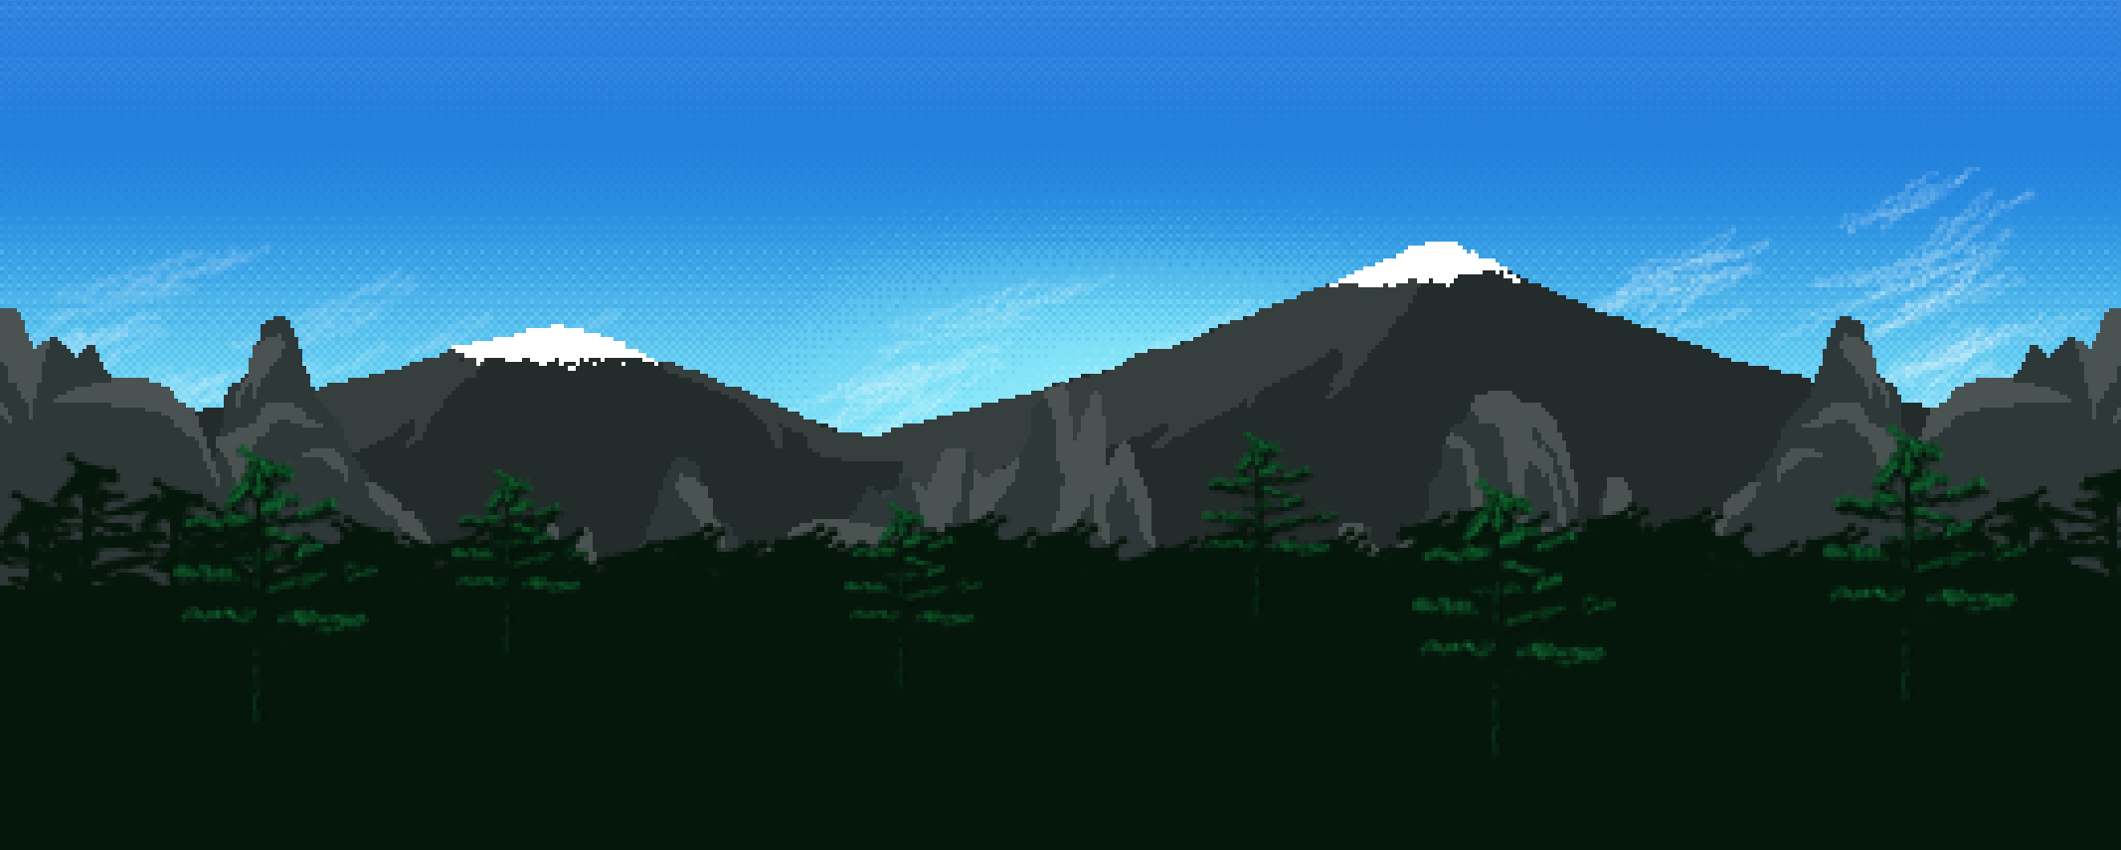
Jasper Ladkin, Thor Madsen, Alex Assante, Zaine Stetich

Slide 2

Our Game
2D Platformer
Developed in Unity
Languages used: C#, SQL
Web application
Student Demographic
Math Orientated
Notes:
Zaine

Slide 3




DEMO
ITERATION 2
Notes:
Alex and Thor

Slide 4

R2 Planned Features
Account Creation
Settings
Map Design
Database
Bug Fixing/Optimization
Notes:
Jasper

Slide 5
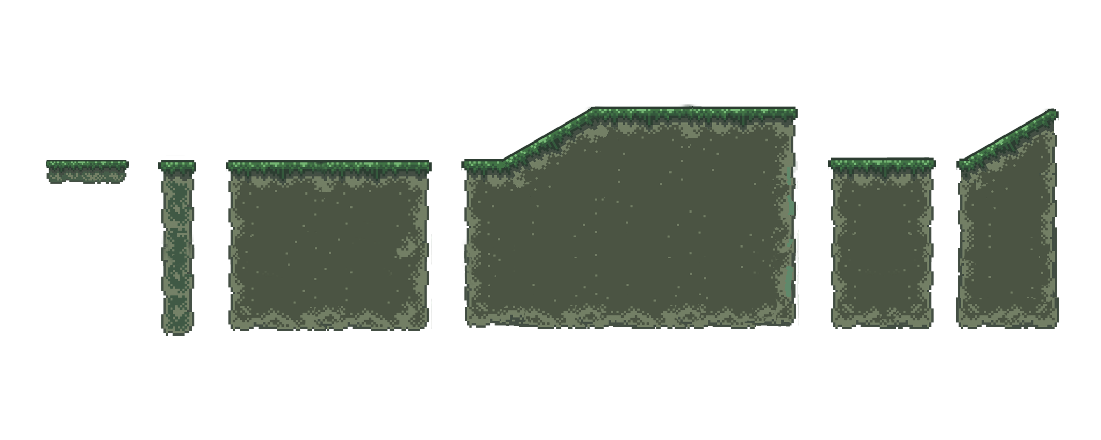
R2 Completed Features
Redesign of the map
User Control Optimization
Menu/Settings
Database Creation
Velocity/Avg Points = 18 (15 R1, 21 R2)
Notes:
Alex:
We redesigned the map and completely redrew the background and the rest of the level
We optimized the user controls by tweaking with the jump force as well as adding in a double jump feature to make it easier to jump between platforms
In this release we were able to incorporate a beginning settings menu as well as accompanying audio features
We also redesigned some of the existing menus and UI and added new Menus
Including adding the login system and account system
We were also able to build our database this release which will allow us tobegin implementing the next features for release 3

Slide 6

Obstacles/Setbacks
Technical Difficulties
Redesigning the map / game
Regular debugging
Database Integration with Unity Web Build
Notes:
Thor

Slide 7
What we did differently in R2 compared to R1
Notes:
Our creation process in R2 differed from our R1 release
Cultural integrity
We structured our time more than we did the first release
During the first release we had loosely structured our working time outside of class but for release 2 we found it much more helpful to structure working time outside of class to meet with each other every week.
There was also a lot more of cross disciplinary work which was very helpful when bug fixing and solving problems during our game creation

Slide 8

Jasper
Features:
Math Curriculum Collection/Organization
Overall Bug Fixing
SqLite Database Creation/Implementation
You guessed it! Even more Bug fixing!
Issues:
SqLite Plugin
Database Implementation
Unity Corruption
Build Issues

Slide 9

Alex
Features:
Menus and UI Elements
Overall Bug Fixing
Implementing Settings and respective Elements
Helping with bug fixing the Builds/Publishing on the web
Issues:
Problems with Menu Mechanics
Problems with Sound Mechanics
Build Problems
Notes:
Alex
The features that I worked on during this release was:
Menus and UI Elements
Overall Bug fixing
The implementation of settings and respective elements
Helping with the building and publishing of our game
The Issue I ran into this release were:
Problems with the menu mechanics
Problems with the sound mechanics
And Build problems
The most tiresome problem was probably an issue within the build and menu mechanics features. The way the menus and scenes are setup in unity uses a drag and drop design to initially build and anchor the different scene mechanics to build each menu/scene. Our unity had multiple issues where A week before and even last night a couple of hours before Unity decided to unanchor/delete some aspects and even entire menus. This resulted in me having to completely rebuild them as trying to recover them from previous commits was not possible. Overall however this Release went smoother than release 1 on my end.

Slide 10

Thor
Features:
Overall bug fixing/optimization.
Updated enemy movement & player mechanics.
Login system & menus.
Helping with implementation of database.
Build/Publish game on the web.
Issues:
Problems with mechanics.
Git issues.
Build Issues
Notes:
Thor

Slide 11

Zaine
Redesigning maps / game
Settings/Main Menu UI + implementation
Map Design
Game Sound/Audio
Maintaining cultural integrity
Issues:
Map Design got scrapped
Unity Corruption
Notes:
Zaine

Slide 12

Wrapping Up
Test cases
Successes
Whats next?
Questions?
Thank you!

